Slide 1
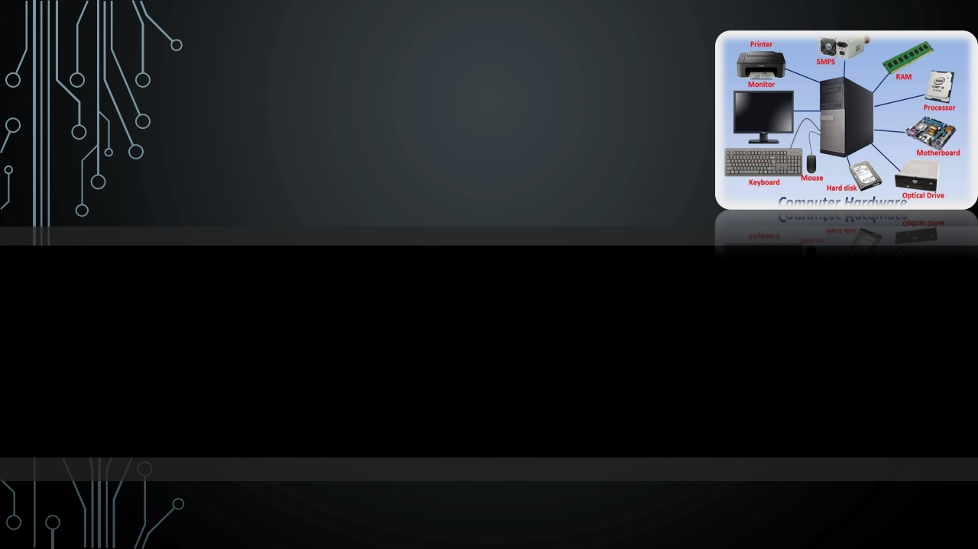
BALASORE SCHOOL OF ENGINEERING
COMPUTER HARDWARE
PRESENTED BY
SUZEN KUMAR MOHANTY BRANCH= COMPUTER SCIENCE & ENGINEERING
ROLL=21O29 REGD =F21024007029
SEMESTER=4TH

Slide 2








CONTENT
1. INTRODUCTION
2. TYPES OF HARDWARE
3. INPUT DEVICE
4. OUTPUT DEVICE
5. MOTHER BOARD
6. GRAPHICS CARD
7. HARDDRIVE
8. ANY QUESTION
9. THE END

Slide 3
INTRODUCTION
•THE INTERNAL COMPONENT OF THE COMPUTER IS BASICALLY DESCRIBE
THE COMPUTER HARDWARE.

Slide 4
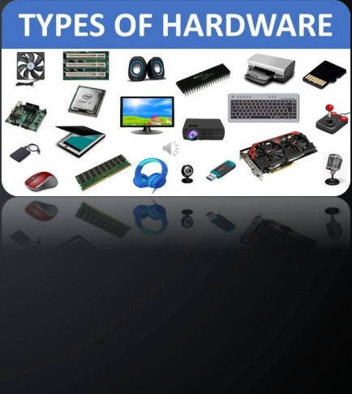
TYPES OF HARDWARE
1) PROCESSOR.
2) MOTHERBOARD.
3) POWER SUPPLY (SMPS).
4) HARD DRIVE.
5) PCI (PERIFRIAL COMPONENT INTER CONNECTED ). 6) GRAFFICS CARD.
7) HIGHPER RAM.
8) INPUT DEVICE.
9) OUTPUT DEVICE .

Slide 5


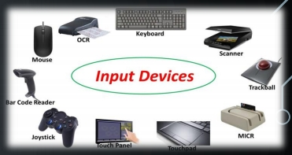
INPUT DEVICE
• THE INPUT SYSTEM CONVENCE THE USER INPUT TO BINARY FORM.
• THE DEVICE TAKES DATA AS INPUT AND CONVERT INTO MACHINE CODE FOR PROCESSING.
• EXP= NIC CARD ,KEY BOARD, MOUSE.

Slide 6
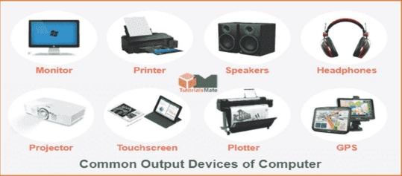
OUTPUT SYSTEM
•THIS OUTPUT SYSTEM CONVENCE FROM THE BINARY BITS OF DATA INTO USER UNDER STABLE FORMET.
1.EX=PEOTLER,MONITOR,PRINTER,SPEAKER
ETC

Slide 7


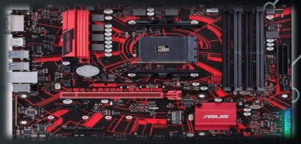
MOTHER BOARD
THE MOTHER BOARD ALSO KNOWN AS MAIN BOARD ON PCB.
THE PCB STANDS FOR PRINTED CIRCUIT BOARD,WHEARE ALL THE
COMPONENTS ARE CONNECTED TO HIS BOARD.
3. SO THAT THE MOTHER BOARD IS CALLED HEART OF A COMPUTER SYSTEM.
4. IT ALSO PROVIDE A SOCKET ARE WHERE A CPU CAN INSTALED.

Slide 8
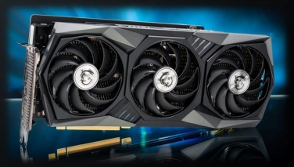
GRAPHICS CARD
1. THIS CARD IS USED TO ENHANCED THE GRAPHICS FOR CREATING THE HIGH DEFINATION MEDIA.
2. IT IS USED TO CREATE VFX AND GAMING CONSAL.

Slide 9
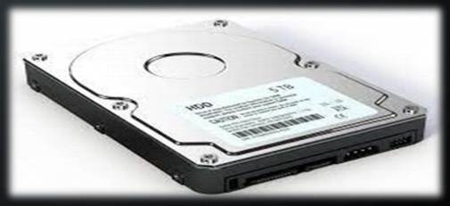
HARDDISKDRIVE
• THE HARD DISK IS A PARMENATE CATEGORY OF MEMORY WHIRE THE DATA STORE PERMANENT PERIOD OF TIME FOR FUTURE USE .
.

Slide 10









Slide 11









